Slide 1




Relationships Between Functionality, Security, and Privacy
For MPC, Hashing, and Encryption
Rio LaVigne
MIT
Notes:
“Expand” MPC in words

Slide 2
Functionality
Security
Privacy
Notes:
Be explicit about the outline of talk is MPC, Hashing, Encryption

Slide 3
Functionality
MPC
Security
Privacy

Slide 4

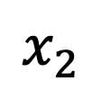
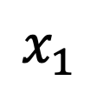
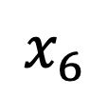
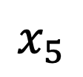
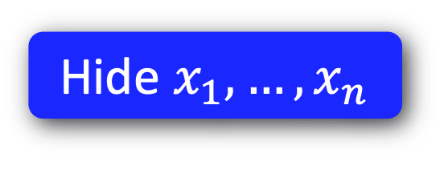
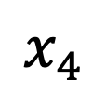
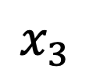
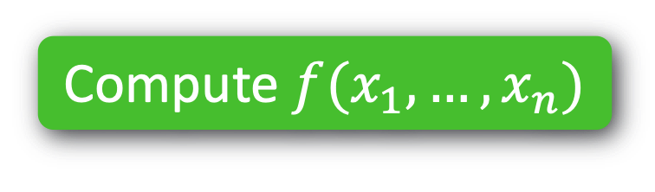
Functionality
MPC
MPC
Security
Passive
Compute $f(x_{1},…,x_{n})$
$$x_{2}$$
Active
$$x_{1}$$
$$x_{3}$$
$$x_{4}$$
$$x_{6}$$
$$x_{5}$$
Hide $x_{1},…,x_{n}$
Privacy
Notes:
All sorts of other things --- polytime vs unbdd

Slide 5
Functionality
Hashing
Security
Privacy

Slide 6
Functionality
Hashing
Security

Slide 7
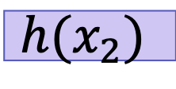

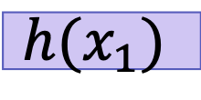

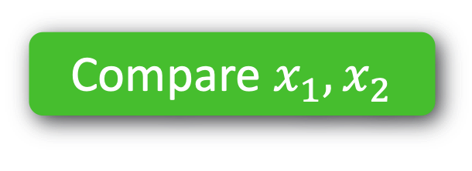

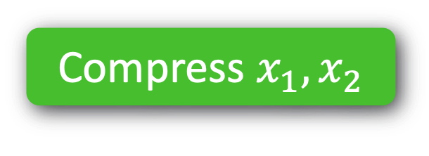


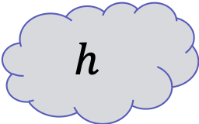
Functionality
Hashing
Security
Compare $x_{1}, x_{2}$
e.g. CRHF
Adaptive
Compress $x_{1}, x_{2}$
$$h$$
$$?$$
$$=$$
$$x_{1}$$
$$x_{2}$$
$$?$$
$$=$$
$$h(x_{1})$$
$$h(x_{2})$$
Notes:
Use technical-sounding terminology

Slide 8
Functionality
Encryption
Security

Slide 9


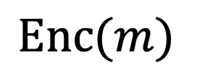
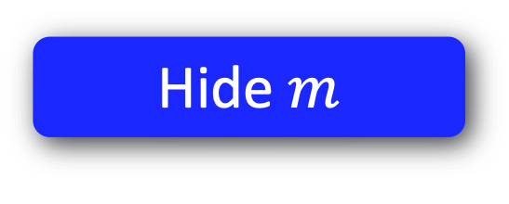

Functionality
Encryption
Security
Send message $m$
Eavesdropper
Poly-time
$$\text{Enc}(m)$$
Hide $m$
Privacy
Notes:
Say: People also look at active MITM

Slide 10
1. MPC with Better Privacy
2. Hashing with Better Functionality
3. Encryption with Better* Security
*subjective & situational
Notes:
SLIDE 10

Slide 11
1. MPC with Better Privacy
2. Hashing with Better Functionality
3. Encryption with Better* Security
*subjective & situational

Slide 12
1. MPC with Better Privacy
1. Topology-Hiding Computation
2. Hashing with Better Functionality
2. Robust Property Preserving Hashing
3. Encryption with Different Security
3. Fine-Grained Cryptography
Notes:
These are the main three directions.. This is what I’m talking

Slide 13
1. Topology-Hiding Computation
2. Robust Property Preserving Hashing
3. Fine-Grained Cryptography

Slide 14
1. Topology-Hiding Computation

Slide 15
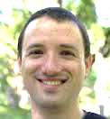
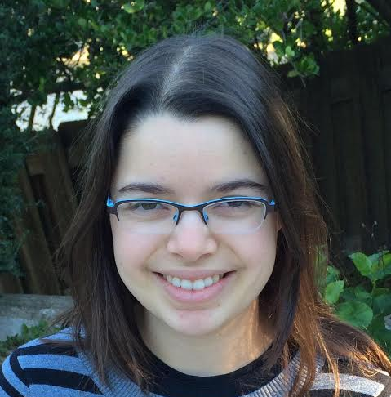

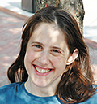
Computes functions on data & graph ☺
Holds personal data & “social graph” ☹
Facebook = “trusted third party”
Notes:
TODO:
Draw myself, Tal, and Adi
Draw FB logo
Draw randos

Slide 16
Goal: Decentralized Social Network
No trusted third party Privacy for data & graph

Slide 17
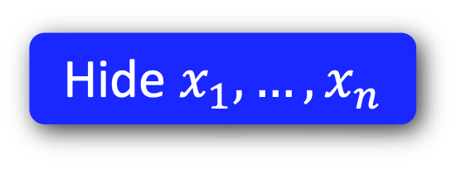
Functionality
MPC
MPC
Security
Passive
Compute $f(x_{1},…,x_{n})$
$$x_{2}$$
Multiparty Computation (MPC) [Yao’86, Goldreich-Micali-Wigderson’87]:
multiple parties can jointly compute a function of their private inputs, while revealing nothing beyond the output
Active
$$x_{1}$$
$$x_{3}$$
Communication topology is public
Complete graph
General public topologies [Dolev-Dwork-Waarts-Yung’93, ..., Halevi-Ishai-Jain-Kushilevitz-Rabin’2016]
$$x_{4}$$
$$x_{6}$$
Hide $x_{1},…,x_{n}$
$$x_{5}$$
Privacy

Slide 18
Functionality
MPC
MPC
Security
Passive
Compute $f(x_{1},…,x_{n})$
$$x_{2}$$
Multiparty Computation (MPC) [Yao’86, Goldreich-Micali-Wigderson’87]:
multiple parties can jointly compute a function of their private inputs, while revealing nothing beyond the output
Active
$$x_{1}$$
$$x_{3}$$
Privacy for your data!
What about metadata?
Communication topology is public
Complete graph
General public topologies [Dolev-Dwork-Waarts-Yung’93, ..., Halevi-Ishai-Jain-Kushilevitz-Rabin’2016]
$$x_{4}$$
$$x_{6}$$
Hide $x_{1},…,x_{n}$
$$x_{5}$$
Privacy

Slide 19
Functionality
MPC
MPC
Security
Passive
Compute $f(x_{1},…,x_{n})$
$$x_{2}$$
Active
$$x_{1}$$
$$x_{3}$$
$$x_{4}$$
$$x_{6}$$
Hide $x_{1},…,x_{n}$
$$x_{5}$$
What about metadata?

Slide 20
Functionality
Topology-Hiding Computation
MPC
MPC
Security
Passive
Compute $f(x_{1},…,x_{n})$
$$x_{2}$$
Active
$$x_{1}$$
$$x_{3}$$
$$x_{4}$$
$$x_{6}$$
Hide $x_{1},…,x_{n}$
$$x_{5}$$
Hide network
Privacy

Slide 21

Functionality
Topology-Hiding Computation
MPC
MPC
Security
Passive
Compute $f(x_{1},…,x_{n})$
$$x_{2}$$
Active
$$x_{1}$$
$$x_{3}$$
$$x_{4}$$
$$x_{6}$$
Hide $x_{1},…,x_{n}$
$$x_{5}$$
Hide network
Privacy

Slide 22
Topology-Hiding Computation [MoranOrlavRichelson15]
Parties have private inputs
Parties communicate directly only with neighbors.
1
8
2
7
3
4
6
5
The Goal: Given minimal information about the graph*
Compute any function of the inputs while revealing nothing beyond function’s output Reveal no more info about the graph
* bounds on diameter / #nodes
Notes:
In more detail, our setting is that parties all have their own private inputs
parties each know who their neighbors are and can communicate directly only with their neighbors
Our goal is to compute any MPC realizable function on the inputs while revealing nothing about the inputs or the graph
beyond minimal information, like the number of nodes or the diameter
To make our lives easier, we only need to realize topology-hiding broadcast. There are standard methods for compiling broadcast into MPC, and if the broadcast is TH, then the MPC will be as well.

Slide 23


Real
Simulated
Sim
1
b_{out}
1
8
2
$$≈$$
8
2
7
3
4
7
3
4
6
5
5
The Goal: Given minimal information about the graph*
Compute any function of the inputs while revealing nothing beyond function’s output Reveal no more info about the graph
* bounds on diameter / #nodes
Notes:
Do I even need this slide?

Slide 24
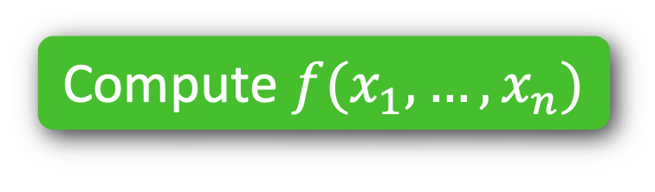
1. Topology-Hiding Computation
Passive
Compute $f(x_{1},…,x_{n})$
Delaying
Hide $x_{1},…,x_{n}$
Hide network
Notes:
Quantum == too unexpected
Remove Quantum
Consider a variety of adversarial models, spectrum from passive to malicious, highlight Delaying

Slide 25
1. Topology-Hiding Computation
Standard Model
Adversary | Graph | Hardness Asm. | Reference
Semi-Honest | Log diam. | Trapdoor Perm | [Moran-Orlav-Richelson’15]
 | Log diam. | DDH | [Hirt-Maurer-Tschudi-Zikas’16]
 | Cycles, trees… | DDH | [Akavia-Moran’17]
 | Arbitrary | DDH, QR | [Akavia-L-Moran17]
Fail-stop | Arbitrary | DDH, QR, LWE | [L-Liu-Maurer-Moran-Mularczyk-Tschudi’18]
Delaying | Cycles | DDH, QR, LWE | [L-Liu-Maurer-Moran-Mularczyk-Tschudi’18]
Notes:
Semi-honest (first three)
(4th row) Start of my PhD ALM
A little more power FS adversary or Delaying => impossible; NEGATIVE RESULTS
FS can get around by allowing for leakage
Delaying, must take power away from Adversary to get any result
One last line: PKCR is key ingredient & thesis contains a construction of PKCR from LWE

Slide 26
1. Topology-Hiding Computation
Standard Model
Adversary | Graph | Hardness Asm. | Reference
Semi-Honest | Log diam. | Trapdoor Perm | [Moran-Orlav-Richelson’15]
 | Log diam. | DDH | [Hirt-Maurer-Tschudi-Zikas’16]
 | Cycles, trees… | DDH | [Akavia-Moran’17]
 | Arbitrary | DDH, QR | [Akavia-L-Moran17]
Notes:
Semi-honest (first three)
(4th row) Start of my PhD ALM
A little more power FS adversary or Delaying => impossible; NEGATIVE RESULTS
FS can get around by allowing for leakage
Delaying, must take power away from Adversary to get any result
One last line: PKCR is key ingredient & thesis contains a construction of PKCR from LWE

Slide 27
1. Topology-Hiding Computation
Standard Model
Adversary | Graph | Hardness Asm. | Reference
Semi-Honest | Log diam. | Trapdoor Perm | [Moran-Orlav-Richelson’15]
 | Log diam. | DDH | [Hirt-Maurer-Tschudi-Zikas’16]
 | Cycles, trees… | DDH | [Akavia-Moran’17]
 | Arbitrary | DDH, QR | [Akavia-L-Moran17]
Fail-stop | Arbitrary | DDH, QR, LWE | [L-Liu-Maurer-Moran-Mularczyk-Tschudi’18]
Impossible [MoranOrlavRichelson15]
Notes:
Semi-honest (first three)
(4th row) Start of my PhD ALM
A little more power FS adversary or Delaying => impossible; NEGATIVE RESULTS
FS can get around by allowing for leakage
Delaying, must take power away from Adversary to get any result
One last line: PKCR is key ingredient & thesis contains a construction of PKCR from LWE

Slide 28
1. Topology-Hiding Computation
Standard Model
Adversary | Graph | Hardness Asm. | Reference
Semi-Honest | Log diam. | Trapdoor Perm | [Moran-Orlav-Richelson’15]
 | Log diam. | DDH | [Hirt-Maurer-Tschudi-Zikas’16]
 | Cycles, trees… | DDH | [Akavia-Moran’17]
 | Arbitrary | DDH, QR | [Akavia-L-Moran17]
Fail-stop | Arbitrary | DDH, QR, LWE | [L-Liu-Maurer-Moran-Mularczyk-Tschudi’18]
Impossible [MoranOrlavRichelson15]
…unless you leak info!
Notes:
Semi-honest (first three)
(4th row) Start of my PhD ALM
A little more power FS adversary or Delaying => impossible; NEGATIVE RESULTS
FS can get around by allowing for leakage
Delaying, must take power away from Adversary to get any result
One last line: PKCR is key ingredient & thesis contains a construction of PKCR from LWE

Slide 29

1. Topology-Hiding Computation
Standard Model
Adversary | Graph | Hardness Asm. | Reference
Semi-Honest | Log diam. | Trapdoor Perm | [Moran-Orlav-Richelson’15]
 | Log diam. | DDH | [Hirt-Maurer-Tschudi-Zikas’16]
 | Cycles, trees… | DDH | [Akavia-Moran’17]
 | Arbitrary | DDH, QR | [Akavia-L-Moran17]
Fail-stop | Arbitrary | DDH, QR, LWE | [L-Liu-Maurer-Moran-Mularczyk-Tschudi’18]
Delaying
Impossible [This Thesis]
SLOW
Notes:
Semi-honest (first three)
(4th row) Start of my PhD ALM
A little more power FS adversary or Delaying => impossible; NEGATIVE RESULTS
FS can get around by allowing for leakage
Delaying, must take power away from Adversary to get any result
One last line: PKCR is key ingredient & thesis contains a construction of PKCR from LWE

Slide 30
1. Topology-Hiding Computation
Standard Model
Adversary | Graph | Hardness Asm. | Reference
Semi-Honest | Log diam. | Trapdoor Perm | [Moran-Orlav-Richelson’15]
 | Log diam. | DDH | [Hirt-Maurer-Tschudi-Zikas’16]
 | Cycles, trees… | DDH | [Akavia-Moran’17]
 | Arbitrary | DDH, QR | [Akavia-L-Moran17]
Fail-stop | Arbitrary | DDH, QR, LWE | [L-Liu-Maurer-Moran-Mularczyk-Tschudi’18]
Delaying
Impossible [This Thesis]
Delays must be a property of network,
not adversarial…
SLOW
Notes:
Semi-honest (first three)
(4th row) Start of my PhD ALM
A little more power FS adversary or Delaying => impossible; NEGATIVE RESULTS
FS can get around by allowing for leakage
Delaying, must take power away from Adversary to get any result
One last line: PKCR is key ingredient & thesis contains a construction of PKCR from LWE

Slide 31

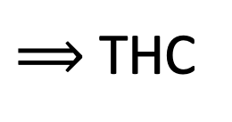
1. Topology-Hiding Computation
Standard Model
Adversary | Graph | Hardness Asm. | Reference
Semi-Honest | Log diam. | Trapdoor Perm | [Moran-Orlav-Richelson’15]
 | Log diam. | DDH | [Hirt-Maurer-Tschudi-Zikas’16]
 | Cycles, trees… | DDH | [Akavia-Moran’17]
 | Arbitrary | DDH, QR | [Akavia-L-Moran17]
Fail-stop | Arbitrary | DDH, QR, LWE | [L-Liu-Maurer-Moran-Mularczyk-Tschudi’18]
Delaying | Cycles | DDH, QR, LWE | [L-Liu-Maurer-Moran-Mularczyk-Tschudi’18]
LWE $⟹$ PKCR
$⟹$ THC
[This thesis]
[AM17,ALM17,…]
Notes:
Semi-honest (first three)
(4th row) Start of my PhD ALM
A little more power FS adversary or Delaying => impossible; NEGATIVE RESULTS
FS can get around by allowing for leakage
Delaying, must take power away from Adversary to get any result
One last line: PKCR is key ingredient & thesis contains a construction of PKCR from LWE

Slide 32
Delaying Adversary Model
b_{out}
Broadcast
Delaying
Polynomially unbounded delay
Change message orders, etc…
SLOW
Notes:
TODO
Reference distributed algorithms of FLB: Byzantine agreements/Broadcast 1982 or 1983
IN THESIS
Mention it here ☺
https://groups.csail.mit.edu/tds/papers/Lynch/FischerLynchMerritt-dc.pdf

Slide 33
Impossibility of THC with Adversarial Delays
1
2
3
4
5
6
7
8
9
10
S
vs.
S
10
9
6
7
5
9
7
3
2
1
Which side is the source on?
Notes:
TODO: renumber

Slide 34

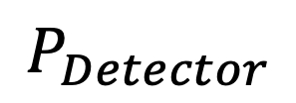
Impossibility of THC with Adversarial Delays
1
2
3
4
5
6
7
8
9
10
S
$$P_{Detector}$$
vs.
S
10
9
6
7
5
9
7
3
2
1
Which side is the source on?

Slide 35
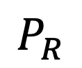
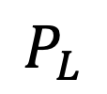
Impossibility of THC with Adversarial Delays
1
2
3
4
5
6
7
8
9
10
S
10
SLOW
SLOW
$$P_{Detector}$$
$$P_{L}$$
$$P_{R}$$
vs.
S
10
9
6
7
5
9
7
3
2
1
SLOW
SLOW
Which side is the source on?

Slide 36
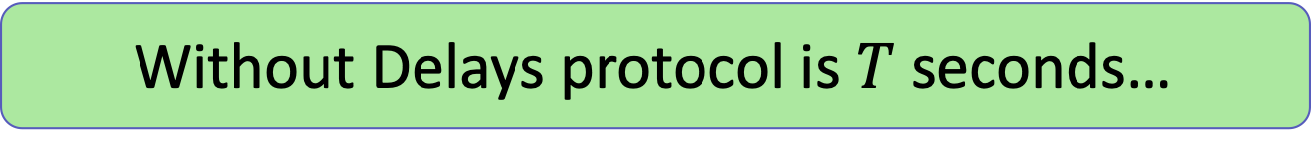
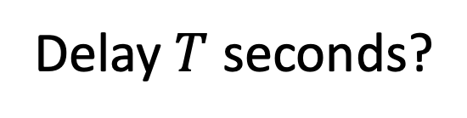
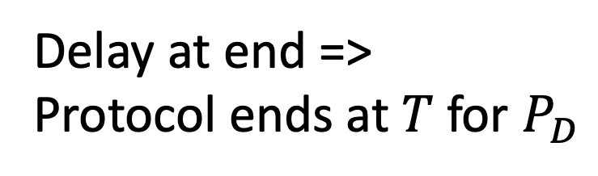
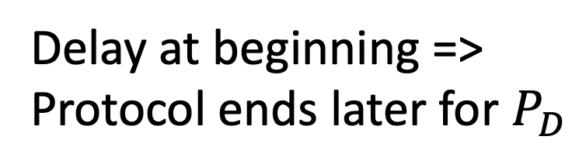
Impossibility of THC with Adversarial Delays
1
2
3
4
5
6
7
8
9
10
S
10
SLOW
SLOW
$$P_{Detector}$$
$$P_{L}$$
$$P_{R}$$
Without Delays protocol is $T$ seconds…
Delay $T$ seconds?
S
10
9
6
7
5
9
7
3
2
1
SLOW
SLOW
Delay at beginning =>
Protocol ends later for $P_{D}$
Delay at end =>
Protocol ends at $T$ for $P_{D}$

Slide 37
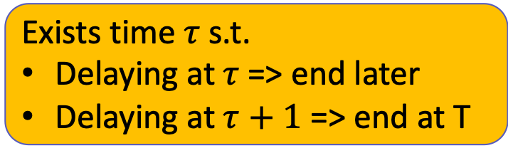
Impossibility of THC with Adversarial Delays
1
2
3
4
5
6
7
8
9
10
S
10
SLOW
SLOW
$$P_{Detector}$$
$$P_{L}$$
$$P_{R}$$
Exists time $τ$ s.t.
Delaying at $τ$=> end later
Delaying at $τ+1$ => end at T
S
10
9
6
7
5
9
7
3
2
1
SLOW
SLOW
Delay at beginning =>
Protocol ends later for $P_{D}$
Delay at end =>
Protocol ends at $T$ for $P_{D}$

Slide 38
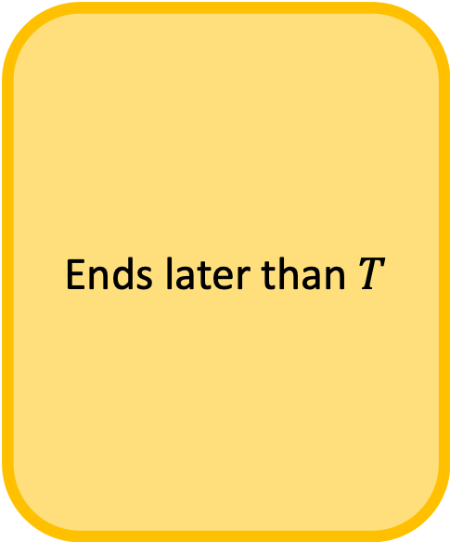
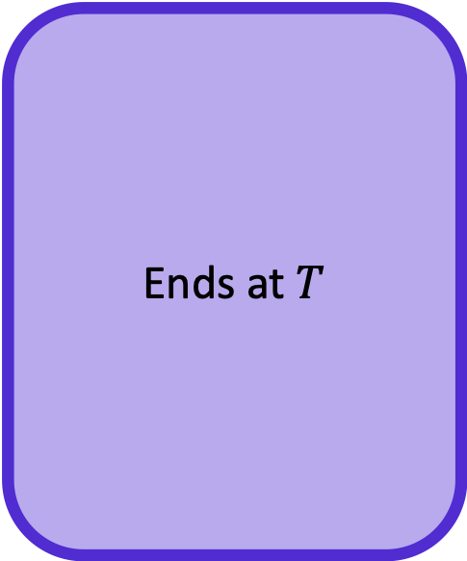
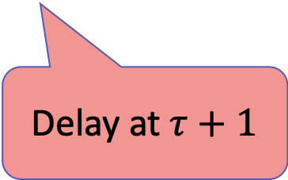
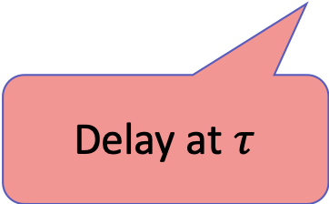
Impossibility of THC with Adversarial Delays
Ends later than $T$
Ends at $T$
1
2
3
4
5
6
7
8
9
10
S
10
SLOW
SLOW
$$P_{Detector}$$
$$P_{L}$$
$$P_{R}$$
Exists time $τ$ s.t.
Delaying at $τ$=> end later
Delaying at $τ+1$ => end at T
S
10
9
6
7
5
9
7
3
2
1
SLOW
SLOW
Delay at $τ$
Delay at $τ+1$

Slide 39
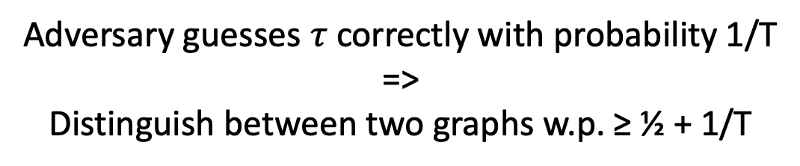
Impossibility of THC with Adversarial Delays
1
2
3
4
5
6
7
8
9
10
S
10
SLOW
SLOW
$$P_{Detector}$$
$$P_{L}$$
$$P_{R}$$
Exists time $τ$ s.t.
Delaying at $τ$=> end later
Delaying at $τ+1$ => end at T
Adversary guesses $τ$ correctly with probability 1/T
=>
Distinguish between two graphs w.p. ≥ ½ + 1/T

Slide 40
Summary of THC results
Quantum-Secure PKCR => Quantum-Secure THC
Via LWE
Adversaries that can delay messages can learn topology
Any THC result dealing with real-world networks must not allow adversarial control over message timings OR must leak information
Lead to positive result in the Probabilistic Unknown Delay Model [LLMMMT20]
SLOW

Slide 41
1. Topology-Hiding Computation
2. Robust Property Preserving Hashing
3. Fine-Grained Cryptography

Slide 42


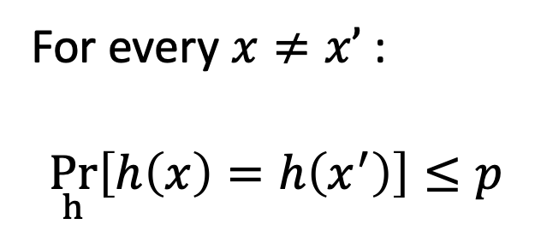
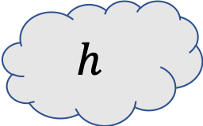
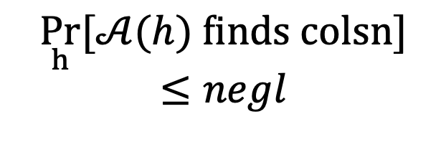
Universal Hash
Collision-Resistant
Hash
For every $x≠x’$:
$$\underset{h}{Pr}\left[h\left(x\right)=h\left(x^{′}\right)\right]≤p$$
$$\underset{h}{Pr}[𝒜(h) \text{finds} \text{colsn}]≤negl$$
$$h$$
Robust
Locality-Sensitive
Hash [This Thesis]
Locality-Sensitive
Hash [Indyk-Motwani‘98]

Slide 43
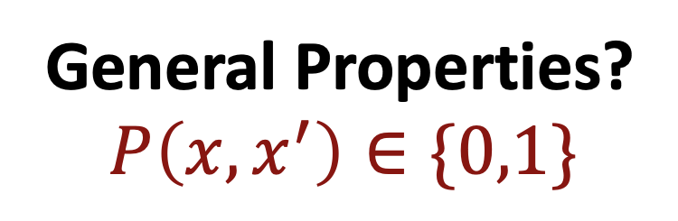
Universal Hash
Collision-Resistant
Hash
For every $x≠x’$:
$$\underset{h}{Pr}\left[h\left(x\right)=h\left(x^{′}\right)\right]≤p$$
$$\underset{h}{Pr}[𝒜(h) \text{finds} \text{colsn}]≤negl$$
$$h$$
General Properties?
$$P\left(x,x^{′}\right)∈\{0,1\}$$

Slide 44
Universal Hash
Collision-Resistant
Hash
For every $x≠x’$:
$$\underset{h}{Pr}\left[h\left(x\right)=h\left(x^{′}\right)\right]≤p$$
$$\underset{h}{Pr}[𝒜(h) \text{finds} \text{colsn}]≤negl$$
$$h$$
Robust
Locality-Sensitive
Hash [This Thesis]
Property Preserving
Hash

Slide 45
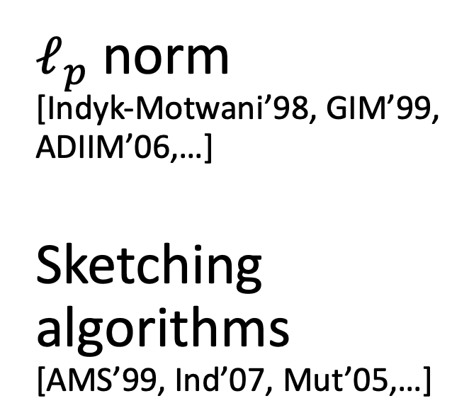
Property-Preserving
Hash
Robust
Property-Preserving
Hash [This Thesis]
$ℓ_{p}$ norm [Indyk-Motwani’98, GIM’99, ADIIM’06,…]
Sketching algorithms [AMS’99, Ind’07, Mut’05,…]
$$h$$
Notes:
Sketching algorithms for graphs etc

Slide 46
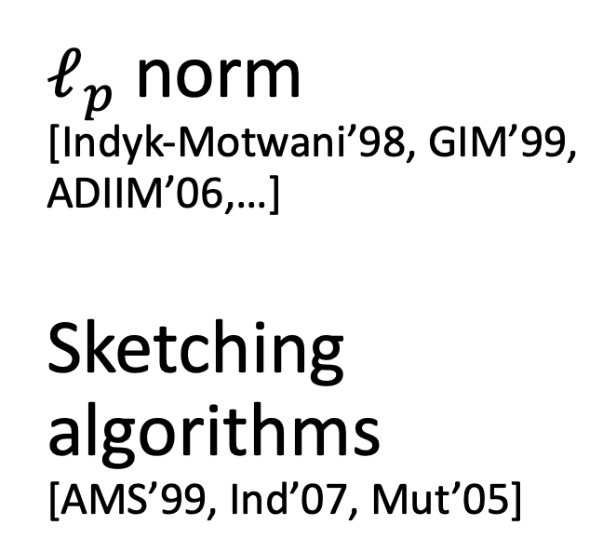
Property-Preserving
Hash
Robust
Property-Preserving
Hash [This Thesis]
$ℓ_{p}$ norm [Indyk-Motwani’98, GIM’99, ADIIM’06,…]
Sketching algorithms [AMS’99, Ind’07, Mut’05]
$$h$$
[HardtWoodruff13]
Impossible from Strengthened Communication-Complexity Lower bounds
[This Thesis]
Gap-Hamming Construction [This Thesis]

Slide 47

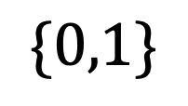
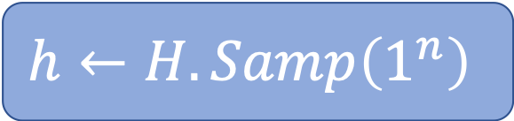
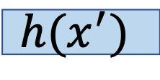

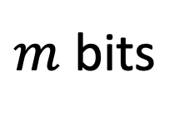

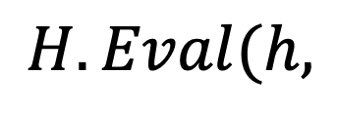

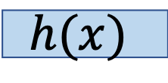

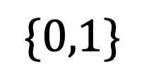
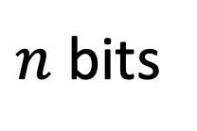
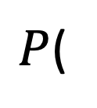
Definitions
Robust PPH family $H$ for two-input predicate $P$
$$h←H.Samp\left(1^{n}\right)$$
$n$ bits
$P$(
$$x$$
$$,$$
$$x′$$
$$)$$
$$\{0,1\}$$
$$H.Eval(h,$$
$$h(x)$$
$$,$$
$$h(x^{′})$$
$$)$$
$$\{0,1\}$$
$m$ bits
and robust

Slide 48

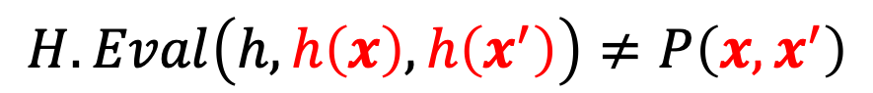



Primary Notion of Robustness
Challenger
$$h←H.Samp\left(1^{n}\right)$$
$$h$$
$(x,x^{′})$ s.t.
$$H.Eval\left(h,h\left(x\right),h\left(x^{′}\right)\right)≠P\left(x,x^{′}\right)$$
Notes:
Non-robust (no h)
-> Gap-Hamming predicate and then construction

Slide 49





Warmup: Equality-Preserving Hash
(Collision-Resistance Hash Families)
Given $h$ sampled from $H$, hard to find a collision
Challenger
$$h←H.Samp\left(1^{n}\right)$$
$$h$$
$(x,x^{′})$ s.t.
$h\left(x\right)=h(x^{′})$ and $x≠x′$
One of $H.Eval$must be incorrect:
$$H.Eval\left(h,h\left(x\right),h\left(x^{′}\right)\right)=H.Eval\left(h,h\left(x\right),h\left(x\right)\right)$$

Slide 50



Warmup: Equality-Preserving Hash
(Collision-Resistance Hash Families)
In other words…
$H$ is CRHF
$$⇔$$
$H$is Equality PPH
Same security guarantees!
Notes:
“We would like to get PPH for properties other than equality, so…”

Slide 51
Gap-Hamming Preserving Hash
$$h$$
Hamming Distance
Adaptive

Slide 52






Gap-Hamming Predicate
Let $P(x,x’)$ be the $(n,d,ε)$ Gap-Hamming Predicate
$$0$$
If $\left|x⊕x^{′}\right|≤d(1 −ε)$
“CLOSE”
$$P(x,x′)=$$
$$1$$
If $\left|x⊕x^{′}\right|≥d(1+ε)$
“FAR”
$$⋆$$
Otherwise
Notes:
So, we focus on the gap-hamming predicate, which instead of just giving equal-or-not, can describe whether two inputs are close or far.
Ideally you want constant fraction for d…

Slide 53
PPH Constructions for Gap-Hamming Distance
Both use same concept
Collision-Resistant Hash functions
Common, weak assumption
New coding-theoretic assumption
Different parameters
Related to hardness of syndrome decoding
Expand
Compress

Slide 54


CRHF Construction
0
0
1
1
0
0
$(n,d,ε)$ Gap-Hamming
Bipartite Expander
Bipartite Expander
$d=O\left(n^{1−δ}\right)$
$ε=O(1)$
Any constant compression!
0
0
0
1
0
1
0
0
CRHF
0
1
1
0
Notes:
Get a larger center d if we assume exponentially secure CRHFs
(idea: subsets in the middle can be smaller)

Slide 55






Landscape of PPH’s
No compression
Lots of Compression
$≥n$ bits
$O(n)$ bits
$ω(log\left(n\right))$ bits
$0$ bits
Constant Gap-Hamming
CRHF Construction
Coding Construction
$$\text{Equality}\text{ (}\text{CRHFs}\text{)}$$
$1/\sqrt{n}$ Gap-Hamming, Index, Greater-than,…
One-Way Communication
[This Thesis]
Notes:
“In the second construction, we can handle d = n/log n.”

Slide 56
1. Topology-Hiding Computation
2. Robust Property Preserving Hashing
3. Fine-Grained Cryptography
Notes:
SLIDE 64

Slide 57

3. Fine-Grained Cryptography
Messaging in O(n^a) time
$O(n^{c})$-Time
C >> a
Messages

Slide 58
“In a world”
… where OWFs don’t exist…
… where BPP is functionally equivalent to NP…
… called Pessiland…
Can we still have meaningful cryptography?
Three intrepid researchers find out…
Three intrepid researchers find out…
Notes:
In a world
Where one way functions don’t exist
Where bpp is functionally equivalent to NP
A world called Pessiland
Can we still have meaningful cryptography
Three intrepid researchers find out!

Slide 59
BPP ≠ NP
(=> P ≠ NP)
Average Case Hard problems
Efficiently generate hard distribution + know solutions
One-Way Function
Efficiently generate hard distribution + trapdoor
Public key crypto
Notes:
TODO: this slide should introduce the core issues of a world without OWFs, why we rely on P ≠ NP for crypto

Slide 60
Rely on increasingly strong assumptions about P & BPP
BPP ≠ NP
(=> P ≠ NP)
Average Case Hard problems
Efficiently generate hard distribution + know solutions
One-Way Function
Efficiently generate hard distribution + trapdoor
Public key crypto
Notes:
TODO: this slide should introduce the core issues of a world without OWFs, why we rely on P ≠ NP for crypto

Slide 61
Can we have a meaningful notion of cryptography even if P=NP?
Notes:
TODO: put this in bold in the middle

Slide 62
Can we have a meaningful notion of cryptography even if P=NP?
YES!
Notes:
TODO: put this in bold in the middle

Slide 63

Related works: Fine Grained Public Key Crypto
Paper | Assumptions | Crypto | Complexity | Adversary Time
[Merkle78] [Biham-Goren-Ishai’08] | $2^{n}$-Strong OWFs | Key Exchange | $$O(N)$$ | $$Ω(N^{2})$$
Notes:
To start off this discussion, let’s mention Merkle Puzzles, the original fine-grained key exchange. Based on either Random Oracles, or very very strong OWFs, we can get a key exchange with an N^2 “gap” between runtime and the time it takes an adversary to break.
But wait, we said we were in a world without OWFs…
Merkle 78
E. Biham, Y. J. Goren, and Y. Ishai. 08,
M. Ball, A. Rosen, M. Sabin, and P. N. Vasudevan 18
A. Degwekar, V. Vaikuntanathan, and P. N. Vasudevan 16

Slide 64

Related works: Fine Grained Public Key Crypto
Paper | Assumptions | Crypto | Complexity | Adversary Time
[Merkle78] [Biham-Goren-Ishai’08] | $2^{n}$-Strong OWFs | Key Exchange | $$O(N)$$ | $$Ω(N^{2})$$
[This Thesis] | Average-Case Zero k-Clique | OWF PKE PKE | $O(N)$ $$O(N)$$ $$O(N)$$ | $$Ω(N^{k/2 })$$ $$Ω\left(N^{1.5−δ}\right)$$ $$Ω(N^{2−δ})$$
Generic properties
Specific properties of Zero-k-Clique
Notes:
Other resources: space (bdd storage Ueli Mauer etc), parallel time (DVV)
n time, n^2 invert
Merkle 78
E. Biham, Y. J. Goren, and Y. Ishai. 08,
M. Ball, A. Rosen, M. Sabin, and P. N. Vasudevan 18
Degwekar, V. Vaikuntanathan, and P. N. Vasudevan 1

Slide 65

Related works: Fine Grained Public Key Crypto
Paper | Assumptions | Crypto | Complexity | Adversary Time
[M78] [BGI08] | $2^{n}$-Strong OWFs | Key Exchange | $$O(N)$$ | $$Ω(N^{2})$$
[Degwekar-Vaikuntanathan-Vasudevan’16] | NC1≠⊕L/poly | OWF + PKE | NC1 | >NC1
[This Thesis] | Average-Case Zero k-Clique | OWF PKE PKE | $O(N)$ $$O(N)$$ $$O(N)$$ | $$Ω(N^{k/2 })$$ $$Ω\left(N^{1.5−δ}\right)$$ $$Ω(N^{2−δ})$$
Generic properties
Specific properties of Zero-k-Clique
Notes:
Other resources: space (bdd storage Ueli Mauer etc), parallel time (DVV)
n time, n^2 invert
Merkle 78
E. Biham, Y. J. Goren, and Y. Ishai. 08,
M. Ball, A. Rosen, M. Sabin, and P. N. Vasudevan 18
Degwekar, V. Vaikuntanathan, and P. N. Vasudevan 1

Slide 66
Can we have a meaningful notion of cryptography even if we don’t have OWFs?
YES!
And can use fine-grained complexity assumptions!
FG Key Exchange
Notes:
TODO: forget definitions and assumptions… directly to construction!

Slide 67










Fine-Grained Assumption Zero k-Clique
Distribution
Complete k-partite graph
$w_{i,j}\sim ℤ_{R}$
$a,b,c\sim [n]$
$w_{a,b}=−(w_{a,c}+w_{b,c})$
$$w_{i,j}$$
$$n$$
$$a$$
$$b$$
Average-Case Assumption
Finding $a,b,c$ takes
$$c$$
$$={Ω(n}^{k})$$
$3$-partite

Slide 68











Fine-Grained Key Exchange Merkle Puzzles?
9
8
7
Input Universe ${\left\{0,1\right\}}^{n}$
6
5
4
1
publish $2^{n/2}$evaluations
2
3
4
4
$$f( )$$
2
$$f( )$$
7
1
2
1
9
$$f( )$$
$$f( )$$
4
4
Key $=$
$$f( )$$
Key $=$
4
4
$$f( )$$
9
7
$$=O({2^{n/2}n}^{2})$$
$$=O({2^{n/2}n}^{2})$$
$$=Ω(n^{k})$$
Notes:
Where does Merkle fail?

Slide 69


Fine-Grained Key Exchange Merkle Puzzles, but different
Generate $ℓ$ ZkC Instances
Plant $\sqrt{ℓ}$solutions
Check Alice’s list for solution
Notes:
Rio

Slide 70




Fine-Grained Key Exchange Merkle Puzzles, but different
Generate $ℓ$ ZkC Instances
Plant $\sqrt{ℓ}$solutions
Check Alice’s list for solution
5. $b=\left\langle i,v\right\rangle$
$$\text{index} i$$
4. Publish $v\sim U_{\log{(ℓ)}}$
$$v$$
Notes:
Rio

Slide 71




Fine-Grained Key Exchange Merkle Puzzles, but different
Time Alice & Bob:
$O(ℓn^{2})$
$O(\sqrt{ℓ})$
$O(\sqrt{ℓ}⋅n^{k})$
Generate $ℓ$ ZkC Instances
Plant $\sqrt{ℓ}$solutions
Check Alice’s list for solution
5. $b=\left\langle i,v\right\rangle$
$$n^{2k−4}$$
$${O(n}^{2k−2 })$$
Notes:
Rio
After minimizing wrt ell and n, we get that A & B only need n^{2k – 2} time to run this protocol.
ell = n^{2k – 4}
… Hope that Eve

Slide 72



Fine-Grained Key Exchange Merkle Puzzles, but different
$$n^{2k−4}$$
$${O(n}^{2k−2 })$$
$${O(n}^{2k−2 })$$
Need a proof!
$$=Ω(n^{3k −4})$$
Notes:
Rio

Slide 73
Fine-Grained Key Exchange Security reduction
LOCATION
of the ZKC
Index of the
ZKC pair
Reduces
i
Notes:
SLIDE 85
Maybe don’t go through the reduction...

Slide 74





Fine-Grained Crypto Summary of Results
Definitions
FG-OWFs and FG-HC bits
FG-KeyXC
FG-PKE
Assumptions
3-Sum and k-Sum
Zero-k-Clique
Constructions
FG-OWF and HC Bits
FG-KeyXC and PKE
$$={O(n}^{2k−2 })$$
$$={Ω(n}^{3k−4 })$$
“Better KeyXC” with gap ${O(n}^{k+2 })$ vs ${Ω(n}^{2k })$

Slide 75
Summary
1. Topology-Hiding Computation
2. Robust Property Preserving Hashing
3. Fine-Grained Cryptography

